Slide 1
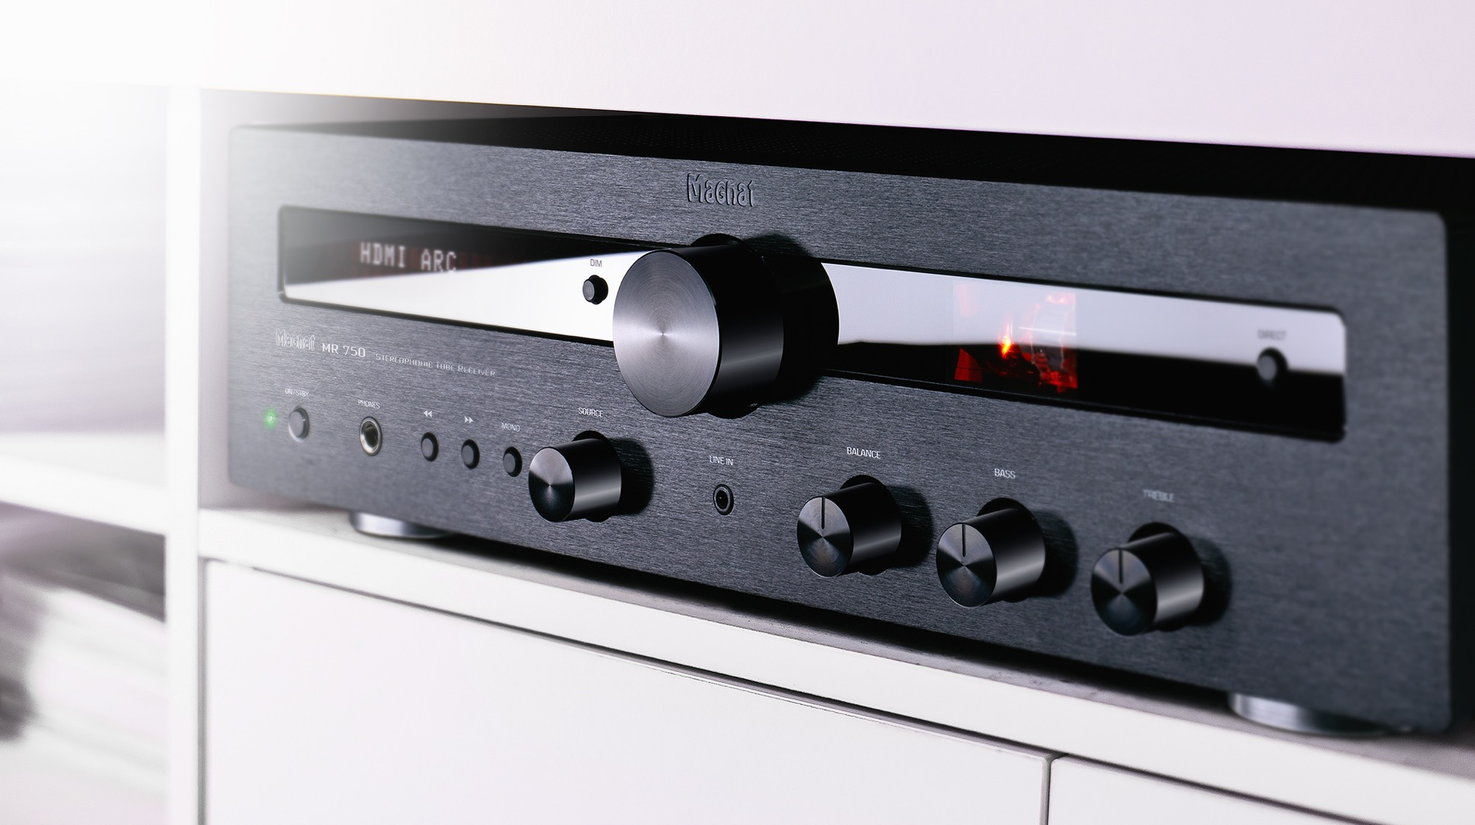

MR 750 – TUBE SOUND & TRANSISTOR PERFORMANCE
Notes:
MAGNAT – MR 750 Sales Deck

Slide 2
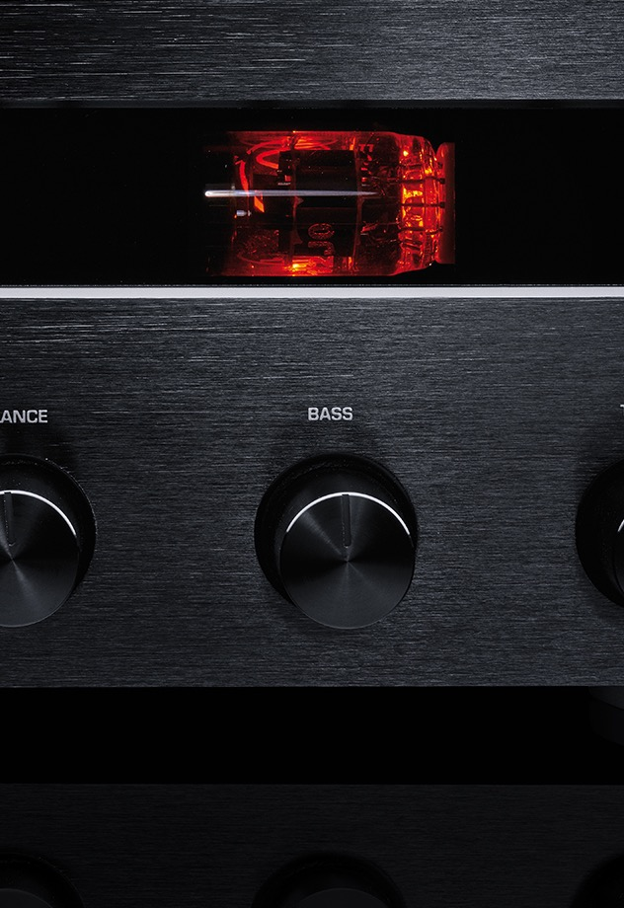
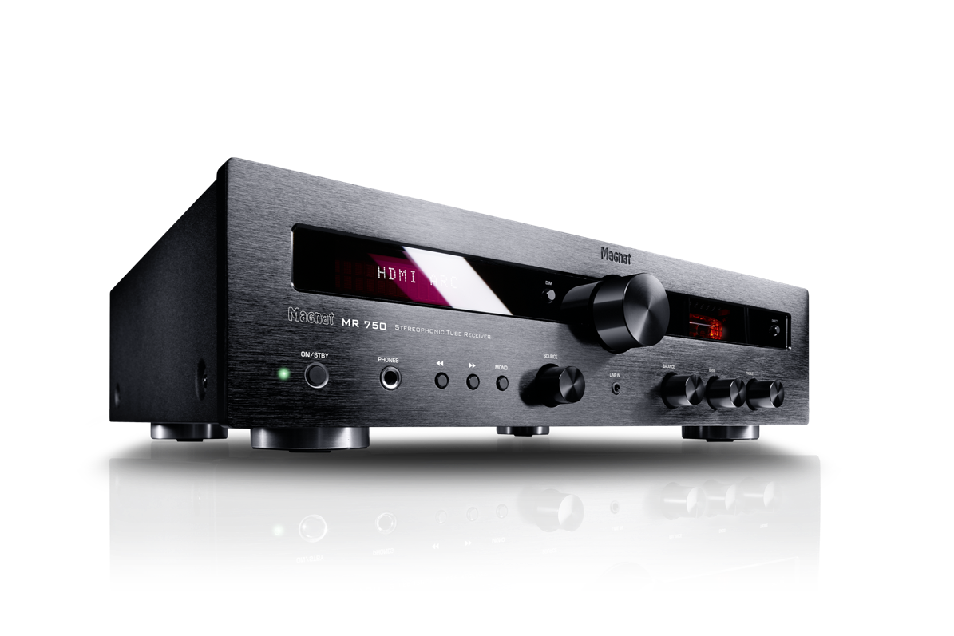
MR 750 – TUBE SOUND & TRANSISTOR PERFORMANCE
HIGHLIGHTS
HDMI INPUT FOR SEAMLESS INTEGRATION OF TV AND ALL CONNECTED SOURCES
SUB OUT CONNECTING FOR USE OF AN EXTERNAL ACTIVE SUBWOOFER
2 X 70 WATTS RMS OUTPUT, 250 WATTS SYSTEM OUTPUT
TWO DIGITAL INPUTS FOR SAMPLING FREQUENCIES UP TO 192KHZ/24BITS
HDMI® WITH ARC AND CEC FUNCTION
(VOLUME CAN BE CONTROLLED VIA TV REMOTE CONTROL)
EXTENSIVE CONNECTIONS, DIGITAL, ANALOGUE,
MM PHONO AND BLUETOOTH aptX (V.5.0)
40 PROGRAMMABLE STATION PRESETS EACH FOR DAB/DAB+ AND FM
SELECTED AND BURNT-IN ECC 81 TUBE (RELIABLE & PARTICULARLY LOW-NOISE)
STURDY FULL-METAL ENCLOSURE WITH SOLID, BRUSHED ALUMINIUM FRONT
MR 750 – SALES DECK
Notes:
MAGNAT – MR 750 Sales Deck

Slide 3








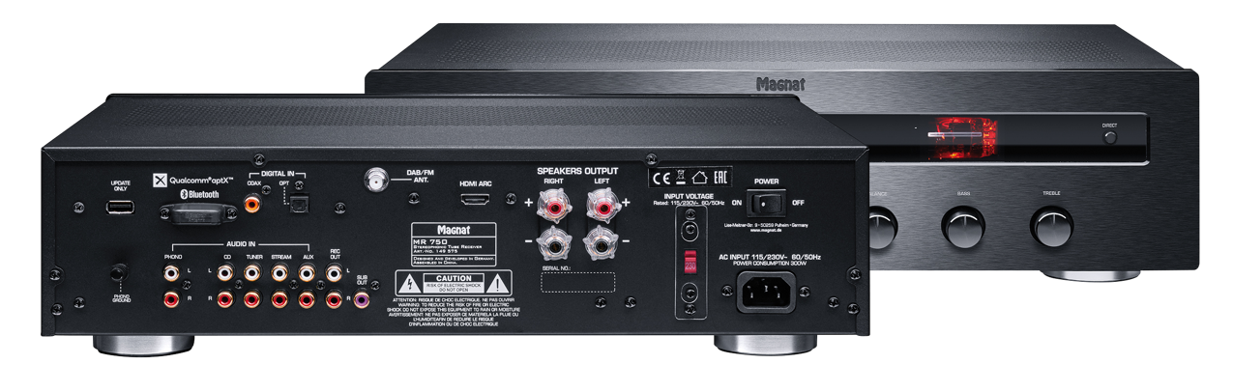
ONE RECEIVER FOR ALL SOURCES
250 WATTS OF MAXIMUM PULSE POWER
HDMI
^{CD PLAYER}
^{TURNTABLE}
^{GAMING}
^{TV}
^{NOTEBOOK}
^{SMARTPHONE}
^{SUBWOOFER (SUBOUT)}
^{STREAMER}
MR 750 – SALES DECK
Notes:
MAGNAT – MR 750 Sales Deck

Slide 4
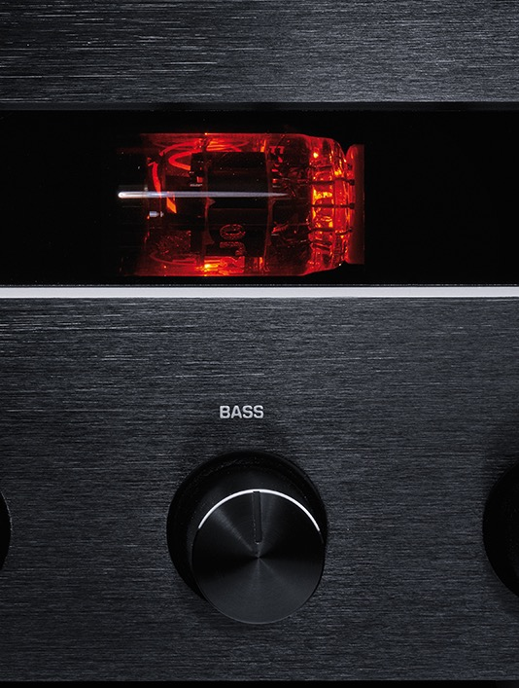
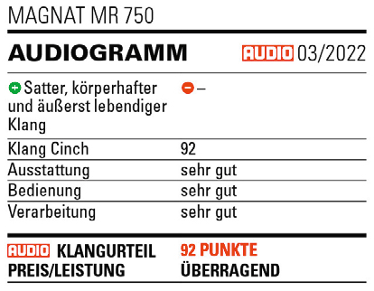
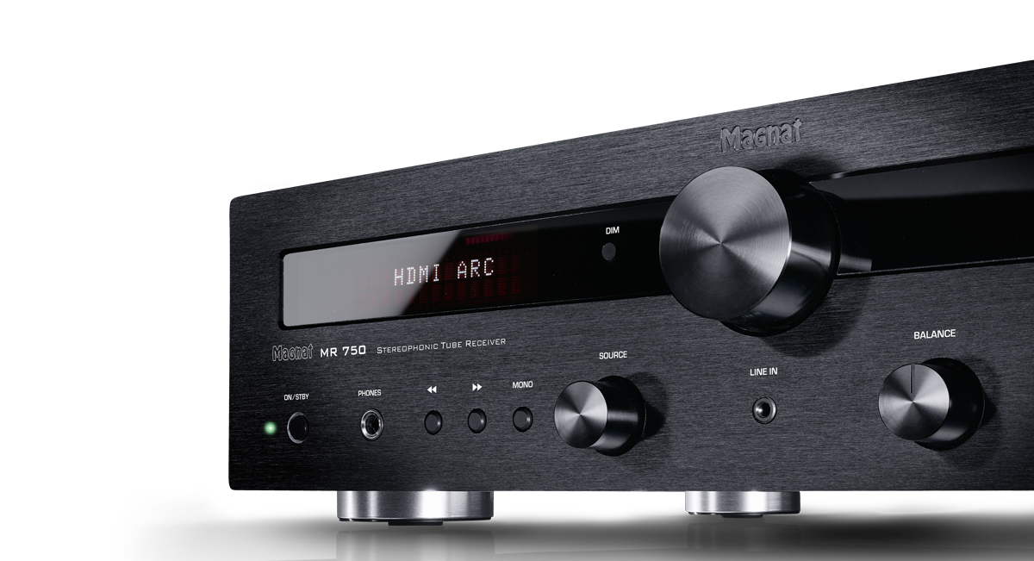
BEST WORKMANSHIP AND ICONIC LOOK
CUSTOMER REVIEWS AND TEST RESULT
"Insane price / performance ratio"
"Of course I had hoped that it would get a lot out of my speakers. But this result I honestly did not expected. Before the decision of buying the receiver I was in some Hifi stores to get some inspiration...meanwhile
I would say that Magnat has managed to produce a device that can play for quite small money in the concert of the big ones!"
^{"Absolutely audiophile ..."}
"I've had a lot of amps, but this one is really worth it.
It beats devices that cost more than twice as much. What comes out of my Bowers and Wilkins here in musicality, playfulness, audiophile sound, is already ingenious to call. More is not possible for the price!!!"
^{Source: Magnat.de}
MR 750 – SALES DECK
Notes:
MAGNAT – MR 750 Sales Deck

Slide 5
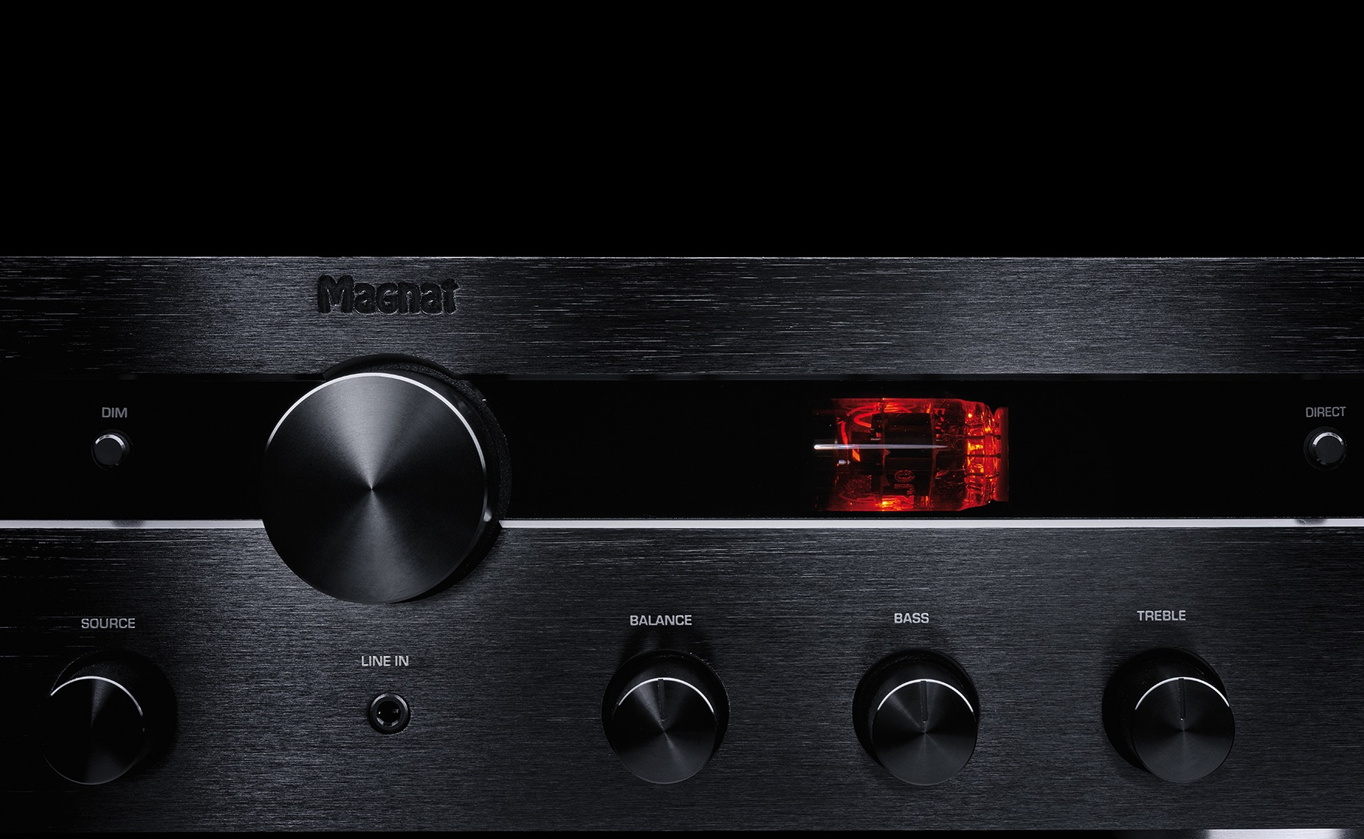
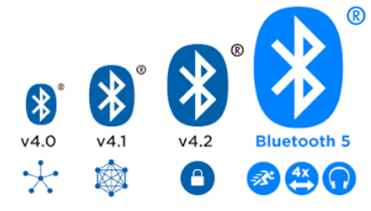
BLUETOOTH 5
HIGHER TRANSMISSION RATE AND RANGE
Whether you're watching movies, gaming, or using any streaming service, you'll be able to
enjoy the right sound in the best possible quality, because the MR 750 has Bluetooth 5 with
Qualcomm aptX on board.
Notes:
MAGNAT – MR 750 Sales Deck

Slide 6
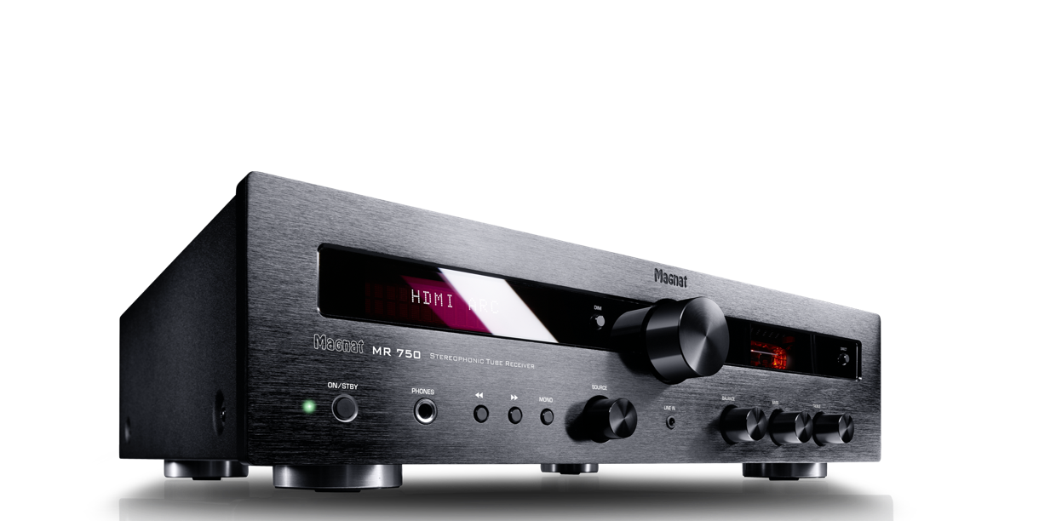
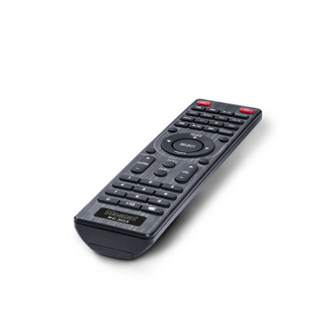
MR 750
TUNER
FREQUENCY RANGE FM 87.5 – 108 MHz
FREQUENCY RANGE DAB/DAB+ 174.928 – 239.2 MHz (Band III)
SENSITIVITY UKW -108 dBm
SENSITIVITY DAB/DAB+ -100 dBm
AMPLIFIER
OUTPUT POWER Nominal power: 20 Hz – 20 kHz, THD < 1.0%, 4 Ω 2 x 70 W 20 Hz – 20 kHz, THD < 1.0%, 8 Ω 2 x 50 W Peak power: 1 kHz, 4 Ω 2 x 125 W
FREQUENCY RESPONSE CD/Streamer/Aux/Line 5 Hz – 100 kHz (-3,0 dB) 20 Hz – 20 kHz (+/-0,3 dB) Phono 20 Hz – 20 kHz (+/-0,8 dB) Subsonic filter 16 Hz, 18 dB/Oktave
S/N RATIO CD/Streamer/Aux/Line 102 dB (A) Digital inputs - Phono (MM) 82 dB (A)
INPUT SENSITIVITY Aux/Line 470 mV/100 kΩ Phono 5 mV/47 kΩ
DIGITAL INPUTS 1 x HDMI Ver. 1.4 (PCM) 1 x optical (Toslink™) 1 x coaxial (Cinch) Supported sampling frequencies: 44.1/48/88.2/96/176.4/192 kHz Supported bit depths: 16/24 Bit
OUTPUTS 1 x Headphone output 6.3mm socket 1 x Subwoofer output (RCH) 1 x Stereo REC output with fixed level
BLUETOOTH® INPUT Bluetooth® 5.0 / Qualcomm aptX® HD
HDMI® INPUT Ver. 1.4 (PCM)
PREAMPLIFIER FITTED WITH 1 x ECC 81
OPERATING FREQUENCY 2402 - 2480 MHz
MAX. ERMITTED POWER ACCOURDING TO EN 62479 1.02 dBm
MAX. POWER CONSUMPTION Maximum: 300 W, Standby: < 0,5 W
AVAILABLE COLORS Black
DIMENSIONS (WxHxD) Main unit: 433 x 116 x 300 mm Incl. Controls and connectors: 433 x 116 x 345 mm Remote control: 45 x 175 x 20 mm
WEIGHT 7.6 kg
SCOPE OF DELIVERY MR 750 Receiver, Remote control incl. batteries, FM/DAB areal antenna Power cord, Instruction manual
ART.NO. / EAN D149575 / 4018843495750
MR 750 – SALES DECK
Notes:
MAGNAT – MR 750 Sales Deck Technische Daten

Slide 7

THANK YOU
Notes:
MAGNAT – MR 750 Sales Deck

