Slide 1
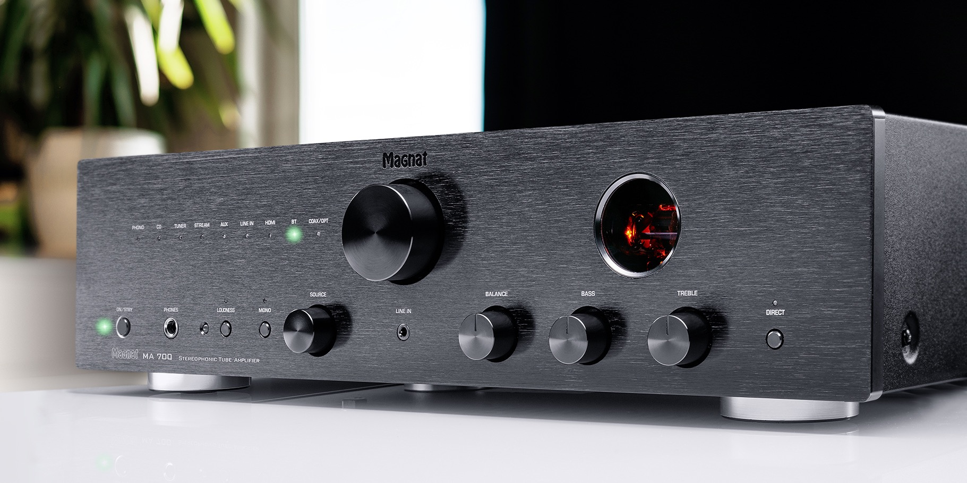
MA 700 – A HYBRID AMPLIFIER FOR ALL MEDIA
Notes:
MAGNAT – MA 700 Sales Deck

Slide 2
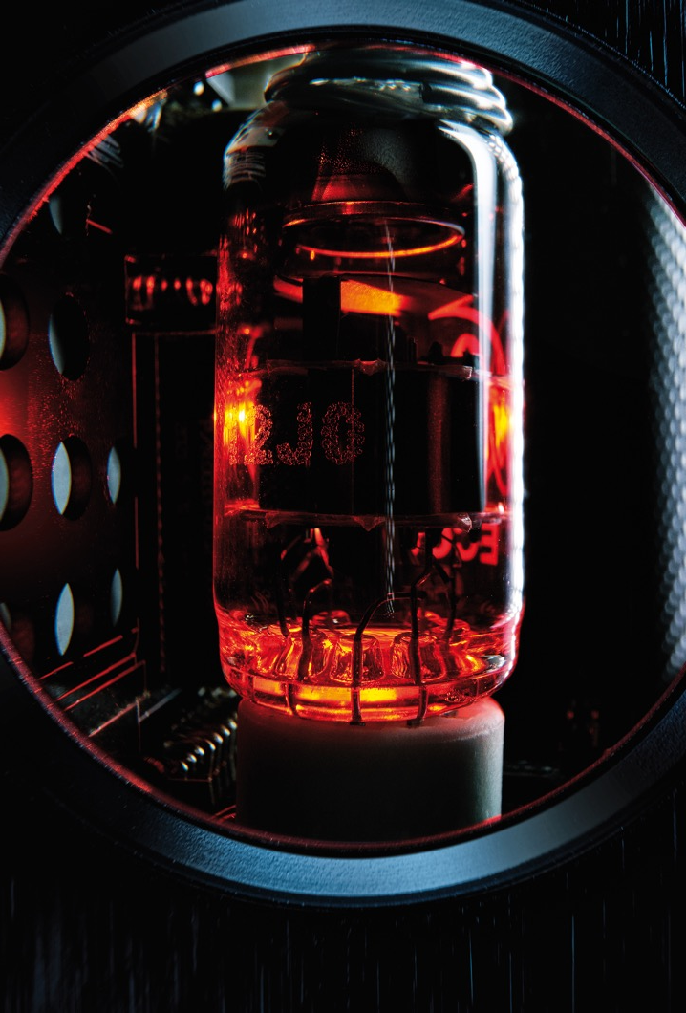
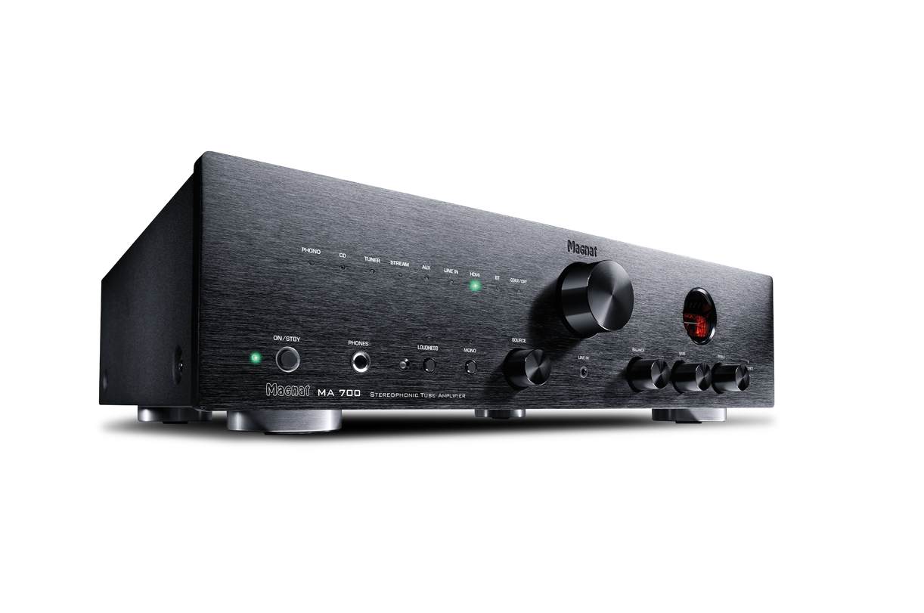
MA 700 – PERFORMANCE AND SOUND
STEREO HYBRID AMPLIFIER WITH TRANSISTOR AND TUBE TECHNOLOGY
HIGHLIGHTS
MM-PHONO PREAMPLIFIER WITH LOW-NOISE OPERATIONAL AMPLIFIERS
AND SUBSONIC FILTERS
HIGH QUALITY DIGITAL-TO-ANALOGUE CONVERTER
2 X 70 WATTS RMS OUTPUT, 250 WATTS SYSTEM OUTPUT
TWO DIGITAL INPUTS FOR SAMPLING FREQUENCIES UP TO 192KHZ/24BITS
SUB OUT CONNECTING FOR USE OF AN EXTERNAL ACTIVE SUBWOOFER
HDMI® WITH ARC AND CEC FUNCTION
(VOLUME CAN BE CONTROLLED VIA TV REMOTE CONTROL)
EXTENSIVE CONNECTIONS, DIGITAL, ANALOGUE,
MM PHONO AND BLUETOOTH aptX (V.5.0)
SWITCHABLE LOUDNESS FUNCTION (AURALLY COMPENSATED VOLUME CORRECTION)
STURDY FULL-METAL ENCLOSURE WITH SOLID, BRUSHED ALUMINIUM FRONT
MA 700 – SALES DECK
Notes:
MAGNAT – MA 700 Sales Deck

Slide 3








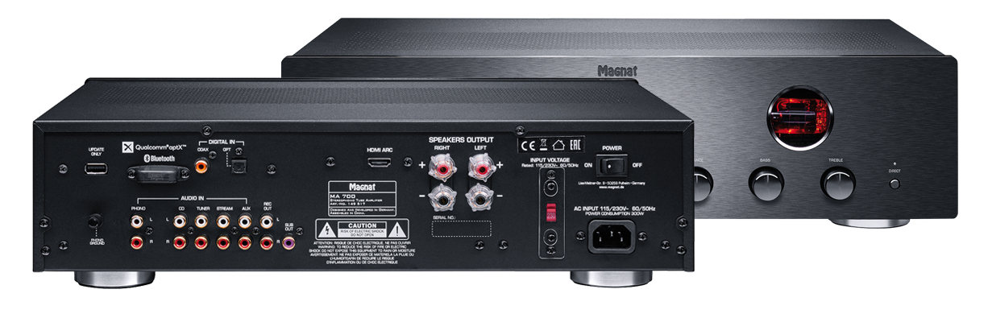
A HYBRID AMPLIFIER FOR ALL MEDIA
250 WATTS OF MAXIMUM PULSE POWER
HDMI
^{CD PLAYER}
^{TURNTABLE}
^{GAMING}
^{TV}
^{NOTEBOOK}
^{SMARTPHONE}
^{SUBWOOFER (SUBOUT)}
^{STREAMER}
MA 700 – SALES DECK
Notes:
MAGNAT – MA 700 Sales Deck

Slide 4
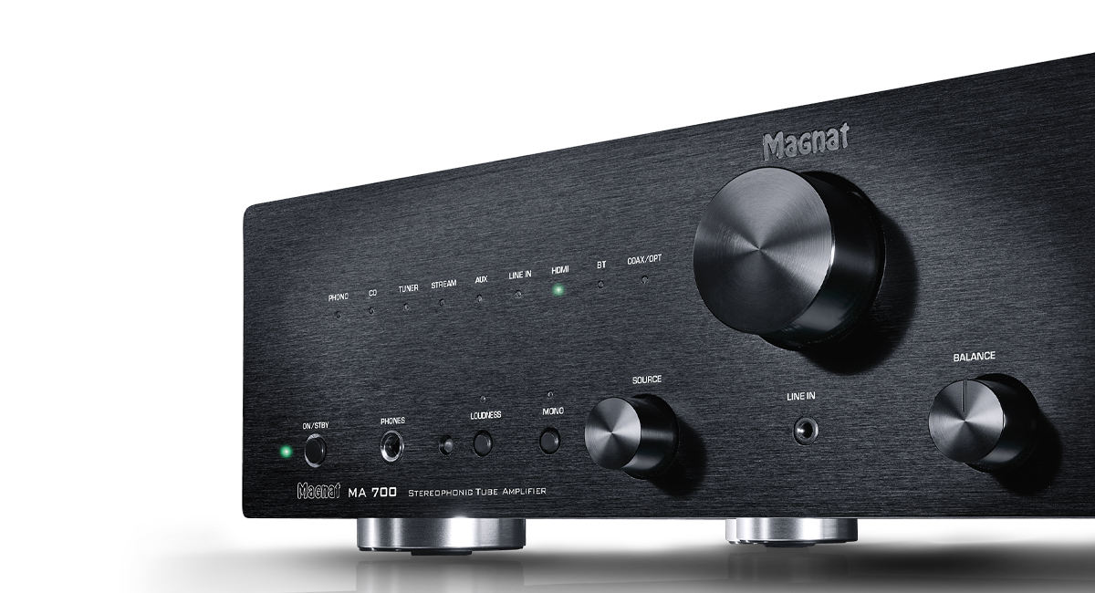


A LOOK THAT WILL LAST FOREVER
CUSTOMER REVIEWS AND TEST RESULT
^{"5 of 5 stars - Great amp!}
I had a Yamaha amplifier before. It had a very good sound. After 15 years it just wouldn't do it anymore.
I was looking for a replacement just as good.
The Magnat then convinced me completely.
Was even a tick better than my good old Yamaha. Not quite cheap, but definitely worth the money!"
^{Source: amazon.de}
MA 700 – SALES DECK
Notes:
MAGNAT – MA 700 Sales Deck

Slide 5
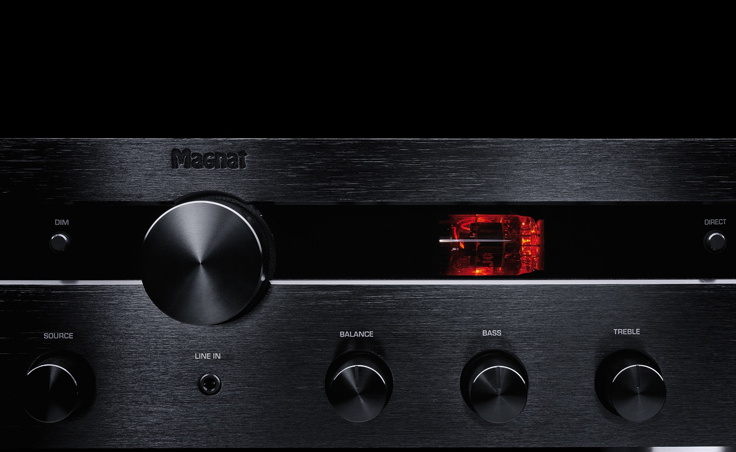
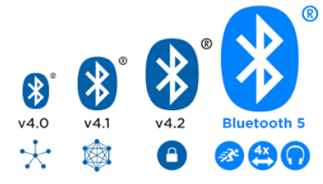
BLUETOOTH 5
HIGHER TRANSMISSION RATE AND RANGE
Whether you're watching movies, gaming, or using any streaming service, you'll be able to
enjoy the right sound in the best possible quality, because the MA 700 has Bluetooth 5 with
Qualcomm aptX on board.
Notes:
MAGNAT – MA 700 Sales Deck

Slide 6
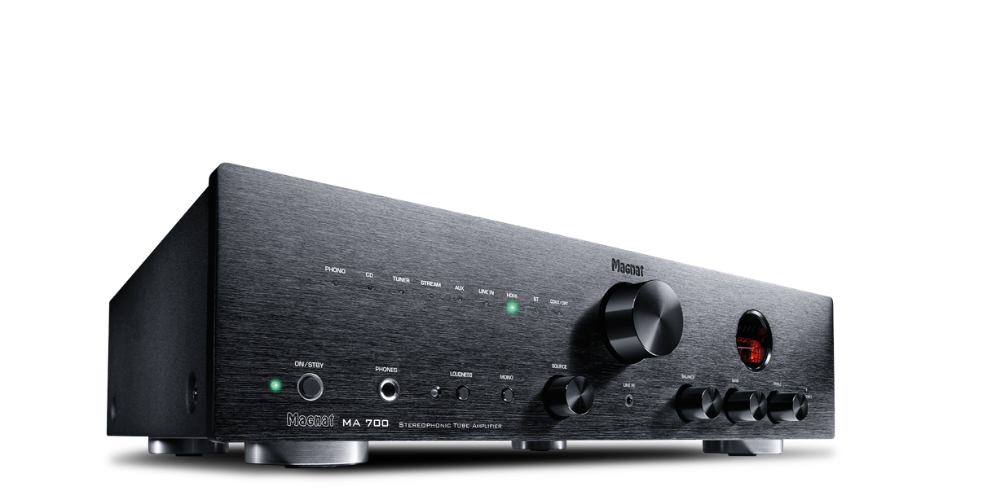
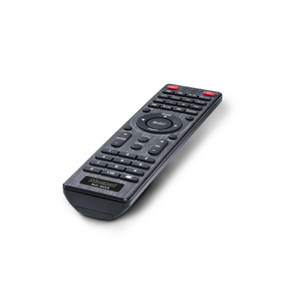
MA 700
AMPLIFIER
OUTPUT POWER Nominal power: 20 Hz – 20 kHz, THD < 1.0%, 4 Ω 2 x 70 W 20 Hz – 20 kHz, THD < 1.0%, 8 Ω 2 x 50 W Peak power: 1 kHz, 4 Ω 2 x 125 W
FREQUENCY RESPONSE CD/Streamer/Aux/Line 5 Hz – 100 kHz (-3,0 dB) 20 Hz – 20 kHz (+/-0,3 dB) Phono 20 Hz – 20 kHz (+/-0,8 dB) Subsonic filter 16 Hz, 18 dB/Oktave
S/N RATIO CD/Streamer/Aux/Line 102 dB (A) Phono (MM) 82 dB (A)
INPUT SENSITIVITY Aux/Line 470 mV/100 kΩ Phono 5 mV/47 kΩ
DIGITAL INPUTS 1 x HDMI Ver. 1.4 (PCM) 1 x optical (Toslink™) 1 x coaxial (Cinch) Supported sampling frequencies: 44.1/48/88.2/96/176.4/192 kHz Supported bit depths: 16/24 Bit
OUTPUTS 1 x Headphone output 6.3mm socket 1 x Subwoofer output (RCH) 1 x Stereo REC output with fixed level
BLUETOOTH® INPUT Bluetooth® 5.0 / Qualcomm aptX® HD
HDMI® INPUT Ver. 1.4 (PCM)
PREAMPLIFIER FITTED WITH 1 x ECC 81
OPERATING FREQUENCY 2402 - 2480 MHz
MAX. ERMITTED POWER ACCOURDING TO EN 62479 1.02 dBm
MAX. POWER CONSUMPTION Maximum: 300 W, Standby: < 0,5 W
AVAILABLE COLORS Black
DIMENSIONS (WxHxD) Main unit: 433 x 116 x 300 mm Incl. Controls and connectors: 433 x 116 x 345 mm Remote control: 45 x 175 x 20 mm
WEIGHT 7.4 kg
SCOPE OF DELIVERY MA 700, Remote control incl. batteries, Power cord, Instruction manual
ART.NO. / EAN D 149575 / 4018843495750
MA 700 – SALES DECK
Notes:
MAGNAT – MA 700 Sales Deck Deck Technische Daten

Slide 7

THANK YOU
Notes:
MAGNAT – MA 700 Sales Deck

